Slide 1
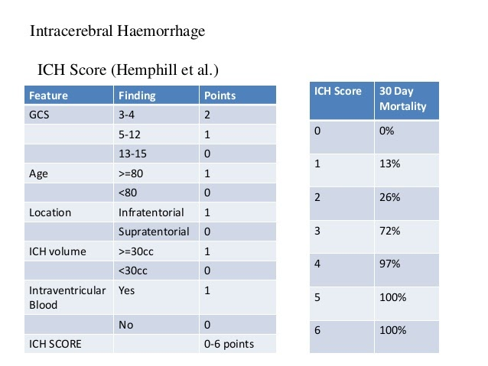
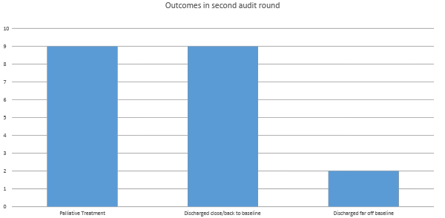
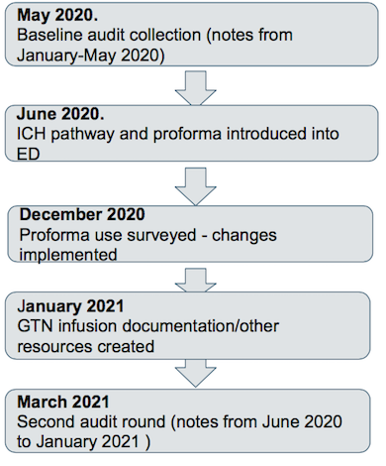
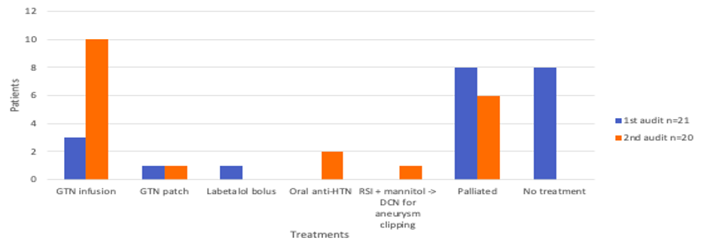
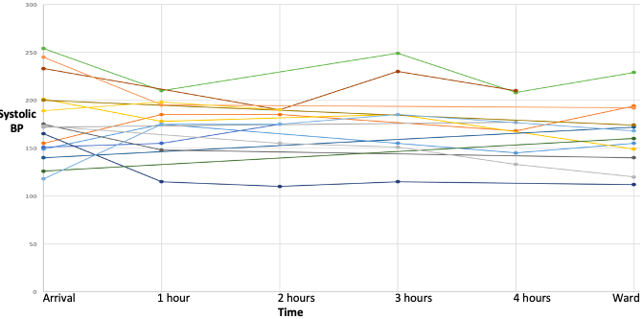
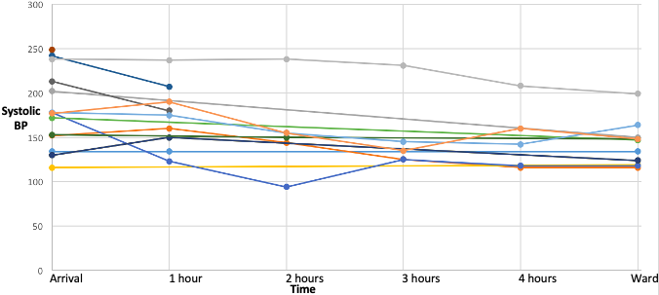
Spontaneous Intracerebral Haemorrhage Management in Fife ED
Quality Improvement Project
Dr Lorna Jackson, Dr Claire Crichton, Dr Emma Godson, Dr Pooja Seta
Victoria Hospital Emergency Department
Introduction
Second audit findings
The intervention from the first audit was the implementation of the first version of our ED spontaneous ICH pathway proforma which highlighted the key outcomes from the NICE 2019 guidelines with input from the NHS Lothian guide.
1. As seen in figure 1 below, of the 20 patients in the second audit, 81% of those who were actively treated were discharged either ear or back to baseline function. This emphasised the importance of timely and effective treatment to reduce the chances of devastating outcomes for our patients.
2. In figure 2 we compare the treatments received in each audit. In the second round there was a three-fold increase in the number of patients started on GTN infusion. In the first audit 8 patients were not treated at all (this does not include those who were palliated). Whereas in the second audit all patients were either actively treated or palliated.
3. Figure 3 compares the systolic BP of each patient in each audit round. It shows us that while we saw improvement in lowering blood pressure we are still a long way off achieving NICE targets.
ICH Score
Survey findings
We responded to these findings with the following:
Re-designed proforma as per feedback: rationalised, validated frailty score
Offered other options for BP control with a new guide to hypertensive medications on blink
Discussion with radiology colleagues re bleed volume
Liaison with medical colleagues to ensure proforma fit for their purposes
Spontaneous intracerebral haemorrhage (ICH) can be defined as ‘intraparenchymal bleeding in absence of trauma or surgery. Spontaneous ICH equates to 10-15% of all strokes in the UK but the outcomes are often most devastating. Our ED department realised that we could optimise our treatment pathway to improve patient outcomes. In 2019, NICE released new guidance on management of ICH . The key targets were:
- timely CT,
-rapid reduction of hypertension,
-reversal of coagulopathies ,
-prevention of secondary brain injury, and
-neurosurgical opinion
A new goal is the rapid control and tight maintenance of systolic BP between 130-40mmHg for the first 24 hours. RCTs (INTERACT-2, ATACH) have shown that early lowering of blood pressure has very few adverse effects and improved morbidity from ICH.
The ICH score predicts mortality at 30 days, based on the above domains. In order to accurately calculate the score, the volume must be worked out. Unfortunately, there were only 2/21 bleed volumes reported in the second audit, however retrospectively working this out, it would not have changed any of the patient outcomes.
Figure 3: Patient outcomes in Second Audit N=20
Positive feedback | Criticism
User-friendly and people knew where to find it | Design issues; rationalising quantity of information and design of ICH score calculation table
Encouraged and standardised aggressive BP control and consideration of anticoagulation reversal | GTN infusion – no dilutent specified, low starting dose of GTN a flaw
Made decision of active intervention vs ‘palliation’ more evidence-based | Use of ‘pre-morbid assessment status’ and not a reproducible frailty scale as per other guidelines
 | No other medications mentioned to lower BP if GTN inadequate
 | Bleed volume not in CT report
Methods
We conducted an audit loop of spontaneous ICH management in the department. Below is the timeline of our project from the beginning of the baseline audit to our findings so far.
Figure 2: Treatments patients’ received in A&E in both first and second audits
Discussion & Conclusion
The key findings from our audit loop were:
Improvement in decision-making around active intervention vs supportive care. Importantly, everyone with a decision not to actively intervene had a DNACPR form put in place.
Better use of GTN infusion and blood pressure control in the ED department .
We are still not aggressive enough with lowering BP in the first hour or in the department.
Volume of bleed was only reported in 2/21 cases in the second audit but interestingly this only changed the score for 3 patients and would not have altered any decisions
Anticoagulant reversal/vitamin K use needs a lot of improvement
From this audit we upgraded our pathway and added a specific GTN infusion chart to ensure regular monitoring of BP in these patients as well as a catered antihypertensive guide on blink.
Figure 3: SBP of each patient in audit 1 (top figure) and audit 2 (bottom figure)
Results
First audit findings
All patients with ICH were hypertensive (minimum SBP >160mmhg) in the department
Of the two thirds eligible & suitable for intensive BP control only half of them received treatment
Huge variation in treatments offered with often no evidence base to support management
Most patients still arriving to the ward with SBP > 140 despite ‘active’ treatment.

