Slide 1
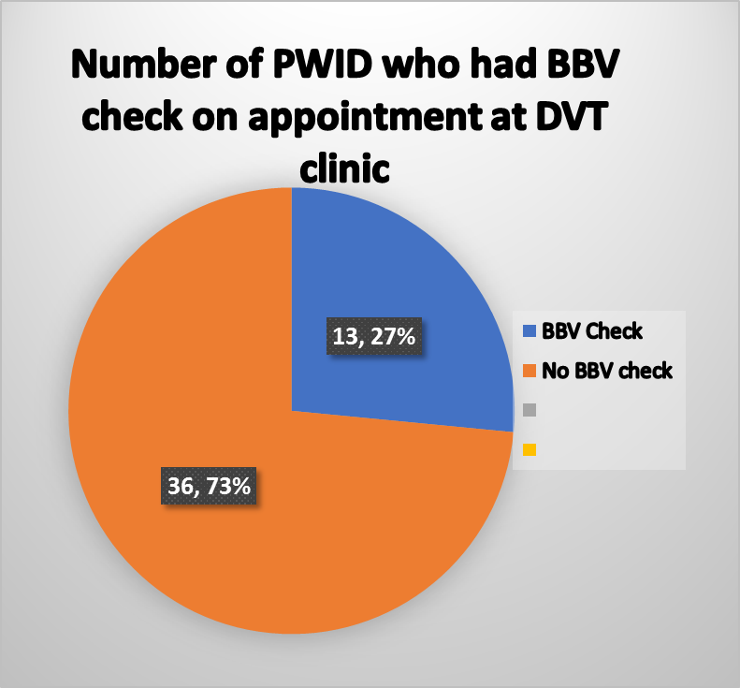
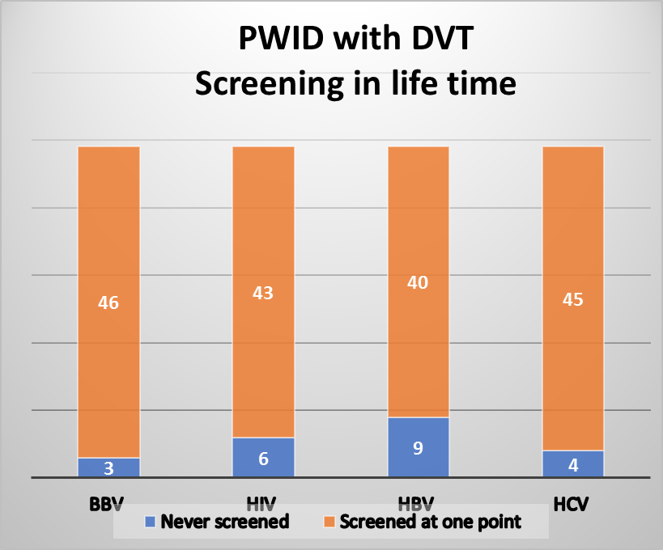
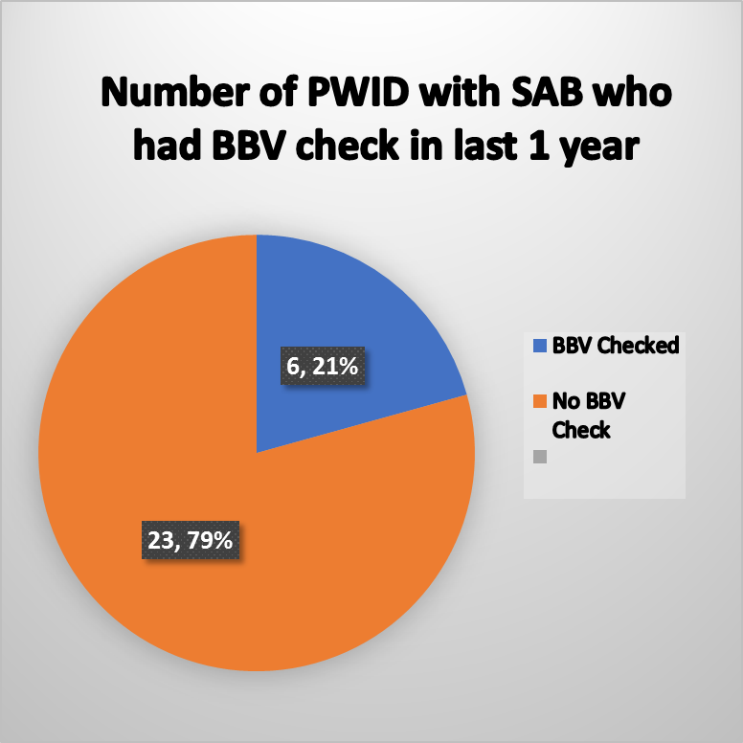
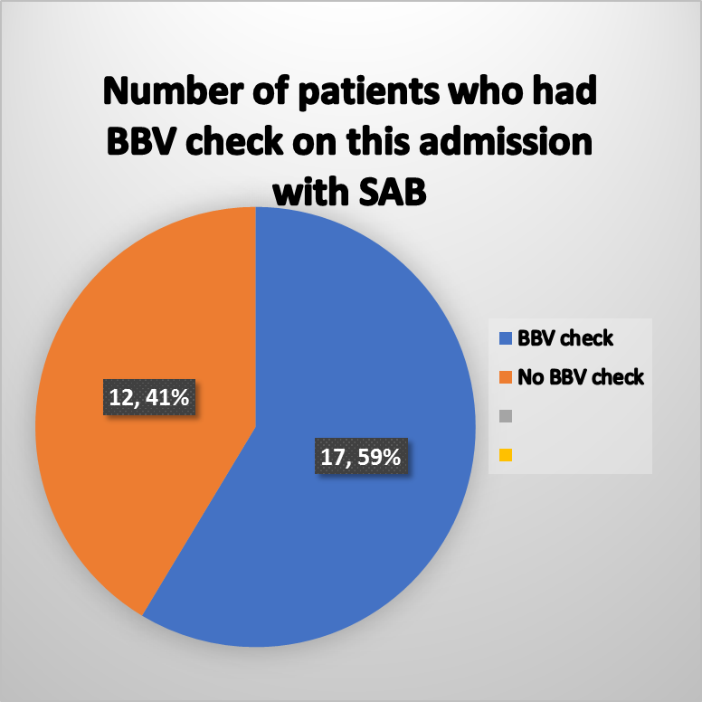
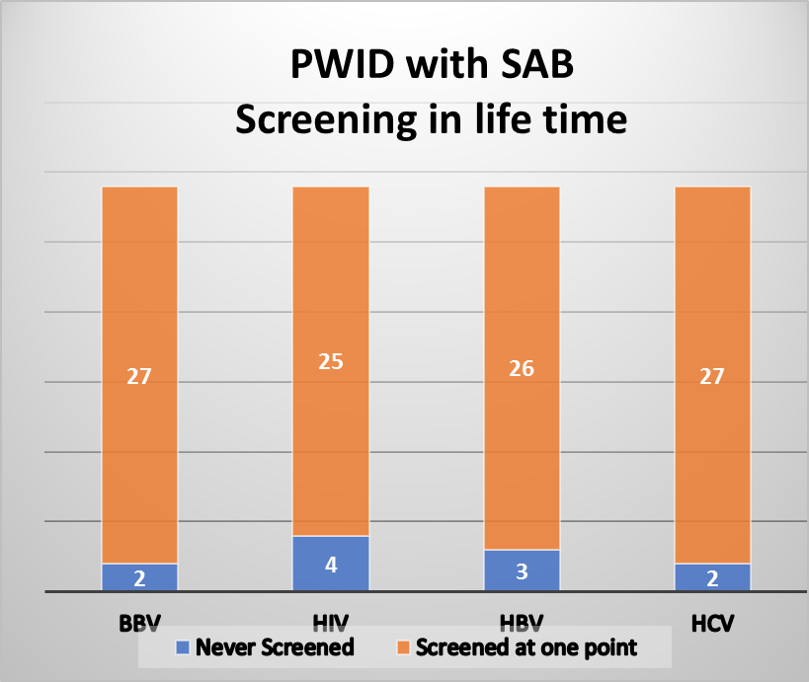
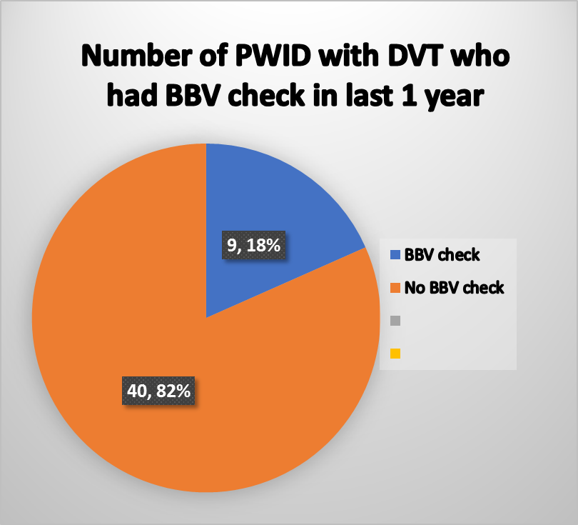
Screening of blood borne viruses (BBV) in high risk group
Authors: Htet Htet Ei Khin* (htethtetei.khin@nhs.scot), Naomi Bulteel (Supervisor)
General Medicine, Victoria Hospital Kirkcaldy
Background: The prevalence of undiagnosed blood-borne virus (BBV) infection in Scotland is unacceptably high. Injecting drug use behaviours are an important source of BBV acquisition.
Results
Elimination targets:
HCV infection and HCV related severe disease and death as a major public health concern by 2024 (Scotland)
HIV transmission by 2030
Viral hepatitis as a public health concern by 2030
Identification of undiagnosed BBV infection is a
“public health priority”
Summary of audit
Only 27% of PWID at DVT clinic were tested for BBV
Only 58% of PWID with SAB were tested for BBV
Patients with SAB seen by the Infection Consult Service were more likely to have BBV screening performed during admission (66.7% v 45%)
Around 10% of PWID did not have any BBV test done in their record
Only 20% of PWID had a BBV test done in the year preceding the study
Question: Are we missing opportunities to screen high risk patients for BBV within the Emergency Care Directorate of NHS Fife?
Recommendations
PWID who present to secondary care with complications of injecting drug use must be tested for BBV infection
Education of health care professionals is required to increase awareness of BBV testing indications and treatment referral pathways

