Slide 1
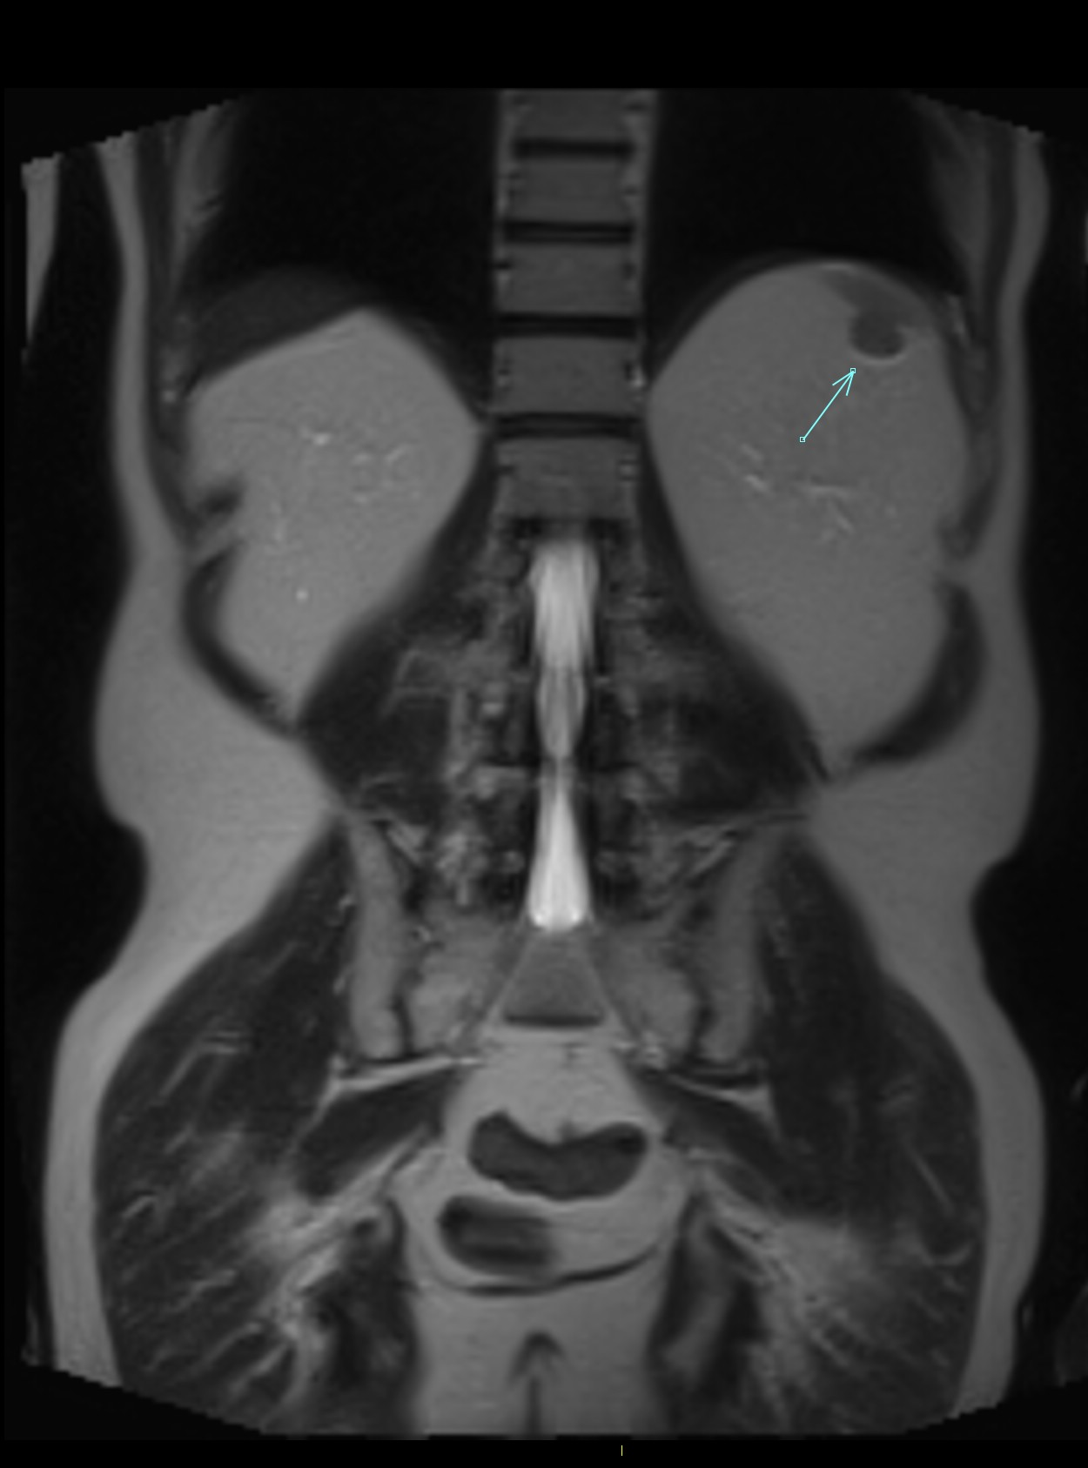
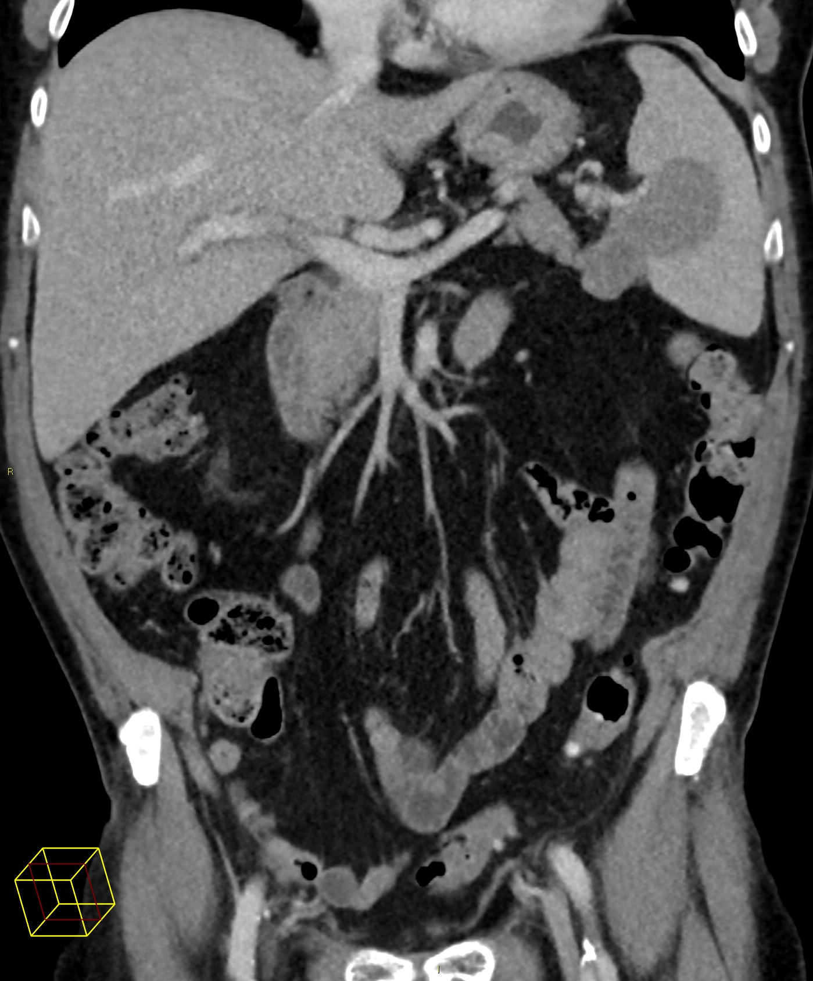
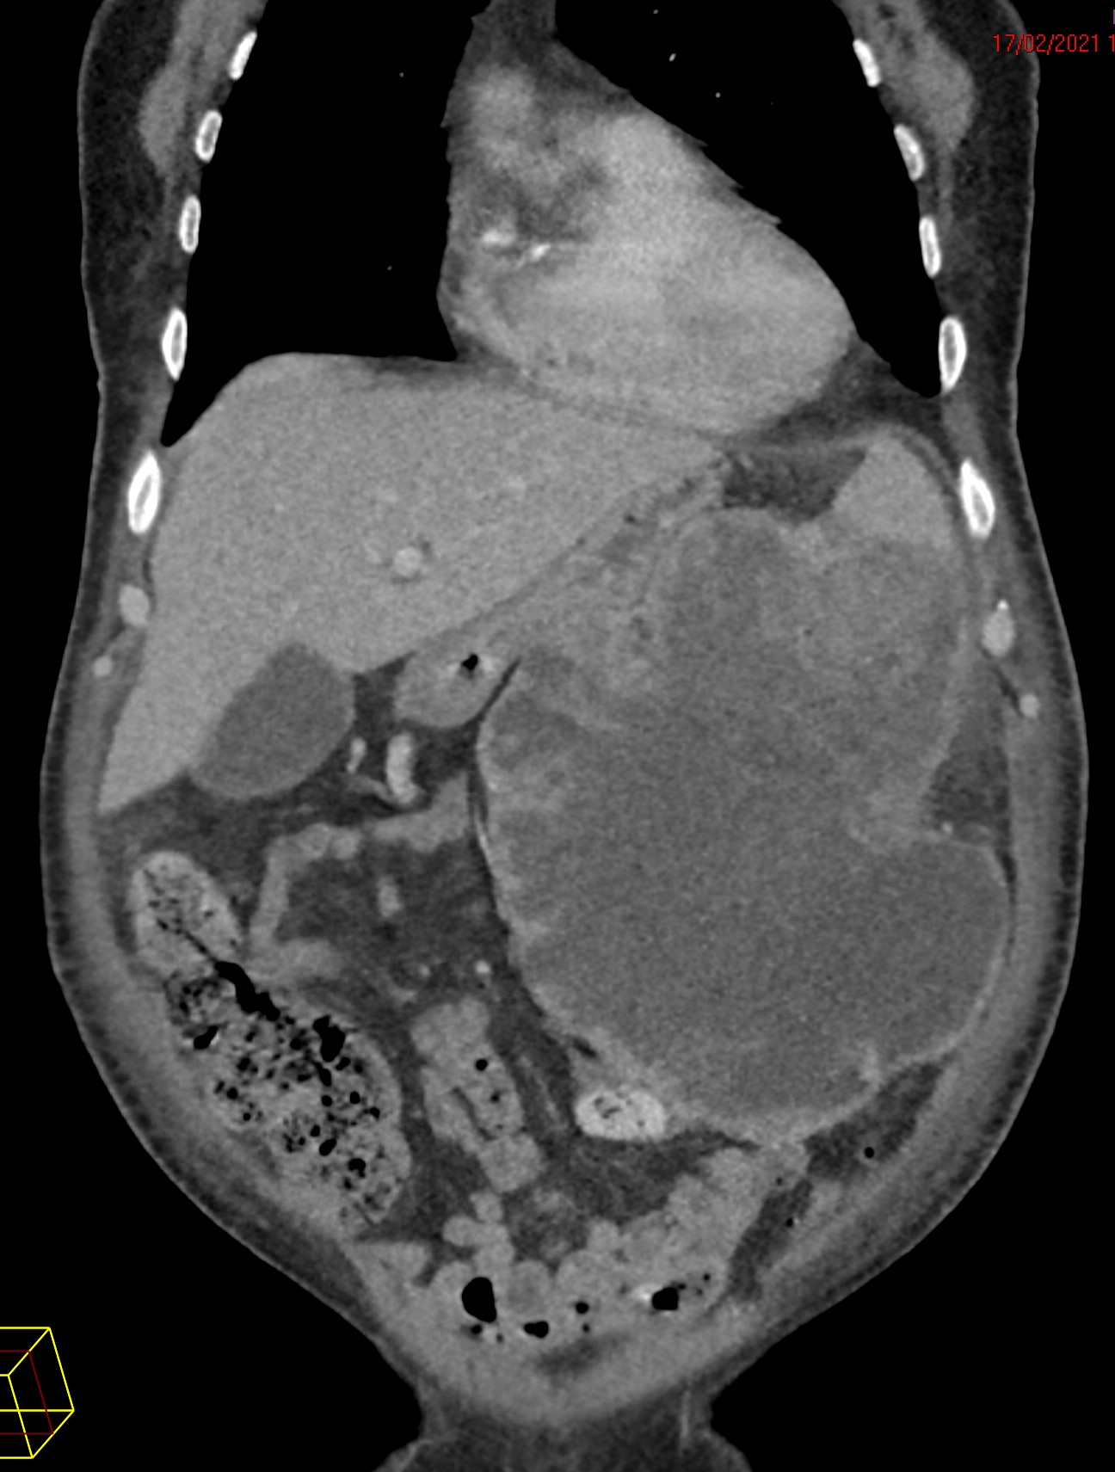
Systemic symptoms and a splenic mass; an unusual case of malignant mesothelioma
Dr Evelyn Qian (evelyn.qian@nhs.scot) General Medicine
Dr Jonathan Serhan, Dr Fiona Murdoch, Dr Ian Fairbairn
1 Introduction
Malignant mesothelioma is an uncommon cancer which classically affects the pleura of the lungs diffusely. Serosa anywhere in the body may be involved. The spleen is an unusual organ to be affected. Our case is additionally unusual as diffuse spread, which is characteristic of mesothelioma, is lacking. Localised malignant mesothelioma (LMM) is a rare and ill-characterized type or subtype of mesothelioma which is often considered suitable for surgical treatment with the aim of long term control and an improved prognosis that that of diffuse malignant mesothelioma (DMM).
Figure: Imaging showed massive, rapid progression: 9cm to 19cm
3 Localised malignant mesothelioma; differences
Classically, malignant mesothelioma develops diffusely across the serosa, caking the membrane, leaving a rind like pattern around organs. This is radiologically diagnostic. Pathologically, mesothelioma is diagnosed with positive mesothelial markers and negative markers for other differentials ⁽¹⁾.
Localised malignant mesothelioma (LMM) lacks the diffuse characteristic and develops concentrically. The diagnosis is ill-defined, though the International Mesothelioma Group (IMG) has recently published a consensus definition. LMM is histologically indistinguishable from the diffuse type. Because of the possibility of diffuse spread unseen by radiology, direct vision by thoracoscopy or laparoscopy was proposed ⁽²⁾ (Table).
Left: MRI 18 months before, retrospectively visible is the tumour (arrow) resembling a splenunculus.
Middle: CT at time of diagnosis of splenic mesothelioma (9cm). Right: CT 2 months after diagnosis (19cm).
2 Vomiting, fevers, hiccups
Our 70 year old gentleman presented with:
2 weeks
Odynophagia
Vomiting and early satiety
Intractable hiccups
2 months
Fevers, rigors, night sweats
Leucocytosis and raised CRP
Loss of appetite
A splenic mass had been found 2 months before which biopsy had identified as epithelioid malignant mesothelioma. PET CT, MRI, and CT CAP had shown no other foci. Retrospectively, the mass could be seen from images 18 months prior, and resembled a splenunculus (Figure; left). Splenectomy with diagnostic laparoscopy had been planned.
This gentleman had previously been living independently with no smoking history. He had previously worked in industries with asbestos exposure.
The following differentials were considered in investigations:
Table: Features of diffuse and localised mesothelioma
 | Diffuse | Localised
Risk factors | Asbestos exposure, male, 60-80 years ⁽³⁾ | Asbestos exposure, male, ?younger ⁽²⁾
Distribution | Pleural 80-90%, abdominal 10-20% ⁽²⁾
Symptoms | Effusions (70%) Localised pain (40%) Weight loss (30%) ⁽³⁾ | Localised symptoms (50%) Asymptomatic (40%) Effusions (20%) ⁽²⁾
Diagnosis | (8th ed AJCC/UICC) Characteristic imaging (e.g thickened pleura) Pathology – positive and negative markers⁽¹⁾ | (IMG panel opinion) Histology Exclusion of other lesions Imaging Direct vision Biopsy Negative cytology ⁽²⁾
Chart: summary of treatment and prognosis
Diffuse | Diffuse (Stage 1/T1N0M0) | Localised
Characteristic imaging, defined immunohistochemical markers. | Limited to the ipsilateral pleural or peritoneal cavity ⁽⁶⁾. | Localised tumour without evidence of diffuse spread.
Treatment with surgical resection
DMM (all)
<1% ⁽³⁾
DMM
(Stage 1/T1N0M0)
59% ⁽⁴⁾
Different types of mesothelioma
LMM
95 – 97% ⁽²⁾⁽⁵⁾
An infographic depicting rate of resection with view to treat reported in the literature.
Prognosis (median survival)
4 A different prognosis?
The interest in diagnosing localised malignant mesothelioma (LMM) is the possibility that combined treatment including surgery might control the disease long term. In contrast, the more common diffuse malignant mesothelioma is mostly not amenable to radical resection with curative intent⁽³⁾. As LMM has mostly been featured through case reports, there has been some attempt to assimilate this data, but prognosis remains uncertain though is potentially more optimistic (Chart).
Radiologically, our patient appeared to have LMM. His rapid deterioration and systemic symptoms may suggest otherwise. Unfortunately this gentleman was no longer fit for laparoscopy and passed away shortly thereafter. His diagnosis of LMM is therefore unconfirmed. Nevertheless his case and presentation reminds us of this diagnosis and its potential for treatment.
Vomiting Odynophagia
?obstruction ?oesophagitis ?diaphragmatic irritation
OGD negative
Lymphocytosis Raised CRP
?deep seated infection ?haematological
CT neck negative Blood film reactive
No response to antibiotics
?change to splenic mass ?paraneoplastic
CT CAP (Figure; right)
DMM (all)
6-18 months ⁽²⁾
DMM
(Stage 1/T1N0M0)
23 - 40 months ⁽⁶⁾
LMM
?? 29⁽⁵⁾- 134⁽²⁾ months ??*
An infographic depicting prognosis reported in the literature.
Chart: Summary of data from a review of the literature comparing diffuse malignant mesothelioma (DMM), early stage diffuse disease, and localised malignant mesothelioma (LMM). *Limited data; anecdotal evidence for surgery with or without chemotherapy aiming to cure.
References: 1. Woolhouse I, Bishop L, Darlison L et al. British Thoracic Society Guideline for the investigation and management of malignant pleural mesothelioma. Thorax. 2018;73(Suppl 1):i1-i30. 2. Marchevsky A, Khoor A, Walts A et al. Localized malignant mesothelioma, an unusual and poorly characterized neoplasm of serosal origin: best current evidence from the literature and the International Mesothelioma Panel. Modern Pathology. 2019;33(2):281-296.
3. Murphy D, Mount A, Starkie F, Taylor L, Aujayeb A. A review of malignant pleural mesothelioma in a large North East UK pleural centre. Pleura Peritoneum. 2020;6(1):13-19.
4. Bovolato P, Casadio C, Billè A et al. Does Surgery Improve Survival of Patients with Malignant Pleural Mesothelioma?: A Multicenter Retrospective Analysis of 1365 Consecutive Patients. Journal of Thoracic Oncology. 2014;9(3):390-396.
5. Gelvez-Zapata S, Gaffney D, Scarci M, Coonar A. What is the survival after surgery for localized malignant pleural mesothelioma?†. Interact Cardiovasc Thorac Surg. 2013;16(4):533-537. 6. Nowak A, Chansky K, Rice D et al. The IASLC Mesothelioma Staging Project: Proposals for Revisions of the T Descriptors in the Forthcoming Eighth Edition of the TNM Classification for Pleural Mesothelioma. Journal of Thoracic Oncology. 2016;11(12):2089-2099.
Notes:
1. Woolhouse I, Bishop L, Darlison L et al. British Thoracic Society Guideline for the investigation and management of malignant pleural mesothelioma. Thorax. 2018;73(Suppl 1):i1-i30. 2. Marchevsky A, Khoor A, Walts A et al. Localized malignant mesothelioma, an unusual and poorly characterized neoplasm of serosal origin: best current evidence from the literature and the International Mesothelioma Panel. Modern Pathology. 2019;33(2):281-296. 3.Murphy D, Mount A, Starkie F, Taylor L, Aujayeb A. A review of malignant pleural mesothelioma in a large North East UK pleural centre. Pleura Peritoneum. 2020;6(1):13-19. 4. Bovolato P, Casadio C, Billè A et al. Does Surgery Improve Survival of Patients with Malignant Pleural Mesothelioma?: A Multicenter Retrospective Analysis of 1365 Consecutive Patients. Journal of Thoracic Oncology. 2014;9(3):390-396. 5. Gelvez-Zapata S, Gaffney D, Scarci M, Coonar A. What is the survival after surgery for localized malignant pleural mesothelioma?†. Interact Cardiovasc Thorac Surg. 2013;16(4):533-537. 6.Nowak A, Chansky K, Rice D et al. The IASLC Mesothelioma Staging Project: Proposals for Revisions of the T Descriptors in the Forthcoming Eighth Edition of the TNM Classification for Pleural Mesothelioma. Journal of Thoracic Oncology. 2016;11(12):2089-2099.
Marchevsky, A., Khoor, A., Walts, A., Nicholson, A., Zhang, Y., & Roggli, V. et al. (2019). Localized malignant mesothelioma, an unusual and poorly characterized neoplasm of serosal origin: best current evidence from the literature and the International Mesothelioma Panel. Modern Pathology, 33(2), 281-296. doi: 10.1038/s41379-019-0352-3
Royal College of Physicians. National Lung Cancer Audit: Pleural mesothelioma report 2016 (for the audit period 2014). London: Royal College of Physicians, 2016
file:///C:/Users/evely/Downloads/2016Meso-report_final_WEB%20(1).PDF
Surgical: 5.2% (2014)

