Slide 1
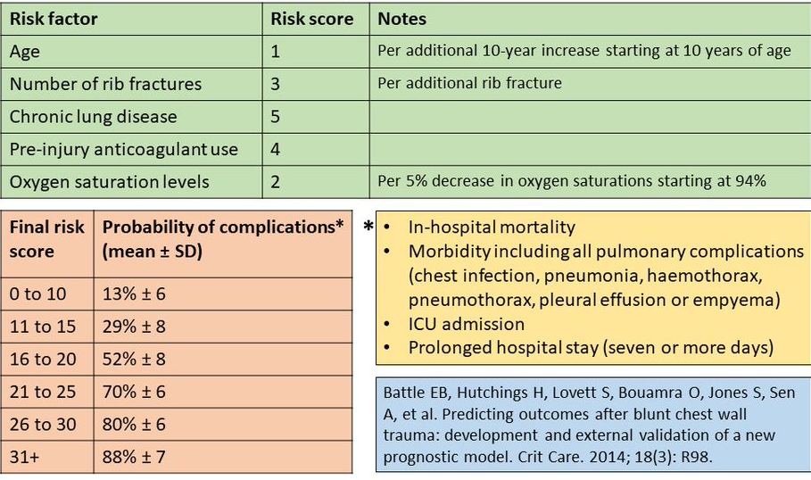
,
Chest Trauma In Victoria Kirkcaldy Hospital
Anna Johnstone¹, Julie Thomson², Alex Von Maydell¹, Deborah Gilliland¹
1. Junior Clinical Fellow, Emergency Medicine. 2. Consultant and Clinical Lead, Emergency Medicine
Introduction
Blunt chest wall trauma accounts for 15% of presentations to the emergency department. Complications don’t occur until 48-72 hours after presentation, making management decisions difficult in early stages (Battle et al., 2014). Battle’s Score is a prognostic model in which 5 risk factors for complications: age; number of ribs fractures; pre-injury anticoagulant use; chronic lung disease; oxygen saturations are used. A score of 16 or more means patients are high risk for developing complications.
Battle’s Score
Methods:
Data was collected retrospectively from patients who presented through A&E over 12 months from November 2019 to 2020. Patients had a chest wall injury and had a hospital stay of 3 or more days. All patients were identified through the Scottish Trauma Audit Group (STAG) data. High risk patients were identified as a Battle’s score of 16 or above. The audit was approved by the Fife Clinical Effectiveness Team.
Results
78 patients were identified. Battle’s score was 15 or less in 40% (31) and 16 or above in 60% (47) patients. 24 high risk patients were admitted to level 1 care, with 21 of these aged 65 or older. The median stay for all patients was 10 days. Those admitted to level 1 care with a Battles’ score of 0-15 or 16+ had a mean length of stay of 11 days verses 23 days. High risk patients admitted to level 2 or 3 care had a mean length of stay of 17 days. High risk patients not admitted to level 2 or 3 care were admitted to a range of medical (35%), orthopaedic (21%) and surgical wards (43%).
Discussion
This audit highlights that patients with high risk injuries are under-recognised, and have no clear pathway for admission. A new protocol has been designed to streamline these patients, recognise their risk level and initiate early physiotherapy, respiratory support and appropriate analgesia. The use of the battle’s score in A&E will aid clinicians in making these decisions, and hopefully lead to shorter admissions with fewer complications.

