Slide 1
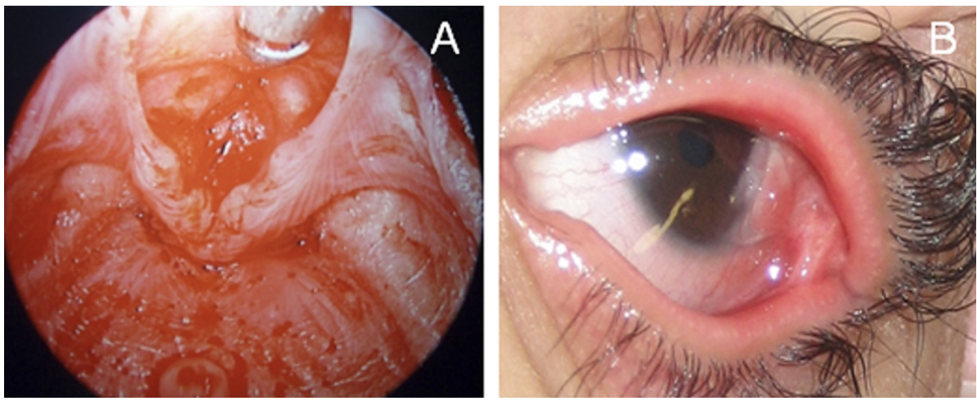
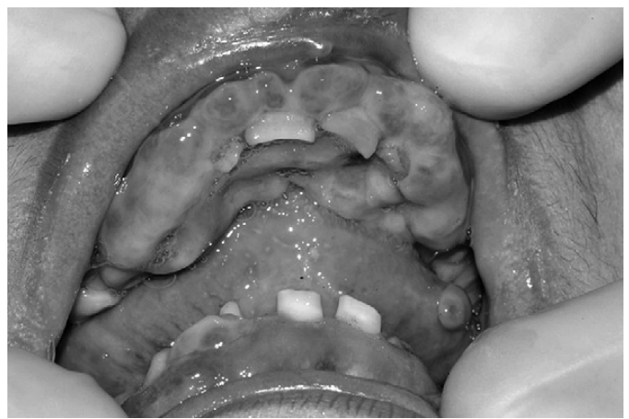
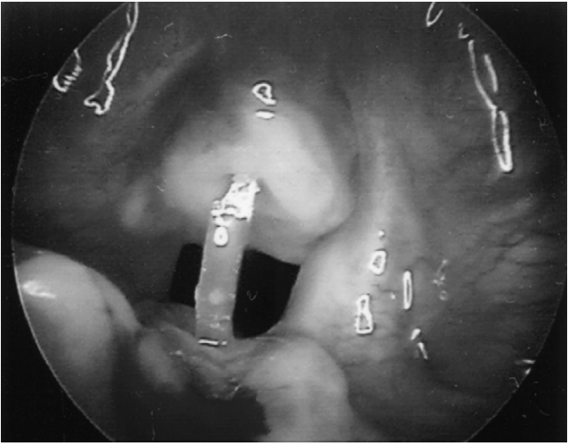
. 2013 Dec;169(6):1353-6. doi: 10.1111/bjd.12522.
Laryngo-onycho-cutaneous (LOC) syndrome
A long-term use of silatic keel for Laryngeal stenosis prevention
. 2013 Dec;169(6):1353-6. doi: 10.1111/bjd.12522.
Warda Jamil*, David Walker
Department of ENT, Victoria Hospital, Kirkcaldy, UK
*warda.jamil@nhs.scot
BACKGROUND
CASE DESCRIPTION
DISCUSSION
LOCs also known as LOGIC (Laryngeal and Ocular Granulation in children) is rare autosomal recessive condition characterised by abnormal growth of granulation tissue in larynx, oropharyngeal mucosa, nail bed and skin (see Fig. 1).
Shabbir (1986)¹, studied 22 children from 12 Punjabi families with presence of LOCS (Knows as Shabbir Syndrome as wel). He attributed this prevalence to consanguineous marriages. This syndrome was not known to the Western world till Anisworth (1991)² noticed laryngeal and ocular granulation tissue in two children from Punjabi families in Glasgow. Less the 50 cases are reported worldwide apart from one case in Iran rest all cases are from Punjabi decedent families of Indian subcontinent³.
Patient Description
A 34 years old lady was seen in ENT clinic for tracheostomy tube change. She require her tracheostomy tube to be changed every 12 weeks.
Patient History
The patient was born into an ethic Punjabi family in Glasgow. In 1990, at age three, she presented with granulomata and epithelial breakdown on her cornea and other mucous membranes. Later she was diagnosed with LOGIC syndrome in 1991. ⁵
In the year 1991, aged four, she required laser treatment for her laryngeal stenosis. This was followed by subsequent four laser treatments for laryngeal stenosis and anterior webbing in the same year. However, tracheostomy was performed to preserve her airway later that year.
She had a short-term silastic keel placed in 1992 to maintain her voice for the first time. This was followed by a number of laser therapies and four short-term keel placements. Each keel placement was limited to a four month period.
At aged 13, a long-term silastic keel placement was made to preserve her voice. The keel was placed between the vocal cord. This arrangement kept her glottis aperture open permitting air transfer, hence giving her a functional voice. Keel placement can be seen in Fig. 3.
One of the fatal complication of LOCS is airway obstruction which ultimately requires tracheostomy to maintain airway. However, voice can not be preserved by tracheostomy.
Historically, three methods are employed for voice preservation for patient with LOCS. They are (i). Using Mitomycin C , (ii). Laser therapy, (iii) using a keele. The first two options prevent re-stenosis while the final one keeps the larynx from closing completely.
Contrary to previous study which suggested increased in granulation tissue formation in larynx from long-term keel placement our case patient did not show any adverse reaction to keel placement.
CONCLUSION
We presented the case demonstrating the success of silastic keel use in preserving the patient’s voice for over 20 years and maintaining the patient’s quality of life.
It can be inferred from the case that silastic keel can be a viable mode of therapy to long-terms voice preservation as compared to using Mitomycin C and/or laser therapy.
Fig. 1. Vocal cord showing granulation tissue (A). Granulation tissue in eye (B)⁴
Onset of symptoms notice during first two weeks of life One of the first presentation of LOCs is hoarse cry preceding cutaneous, ocular and airway symptoms. LOCs had very high childhood mortality rate. Progression of disease abate after first decade of life though leaving patient with sever morbidities.
LOCs is consider subtype of JEB (junctional epidermolysis bulla) which happens due to mutation of LAMA 3 gene.
LAMA3 gene carries coding for alpha subunit of protein called Laminin 332. This protein plays a vital in attaching epidermis to dermis and regulate wound healing (see Fig . 2.)
REFERENCES
1. G.Shabbir, M.Hassan, A.Kazmi, Laryngo-onycho-cutaneous syndrome: a study of 22 cases, Biomedica 2 (1986) 15—25.
2. J.R.Ainsworth, A.F.Spencer, J.Dudgeon, N.K.Geddes, W.R.Lee, Laryngeal and ocular granulation tissue formation in two Punjabi children: LOGIC syndrome, Eye 5 (1991)717—722.
3. M. Barzegar et al. A new homozygous nonsense mutation inLAMA3A underlying laryngo-onycho-cutaneous syndrome . Br J Dermatol. 2013 Dec;169(6):1353-6
4. W.H.McLean, A.D. Irvine, K.K.Hamill, et al. An unusual N-terminal deletion of the laminin alpha3a isoform leads to the Chronic granulation tissue disorder laryngo-onycho-cutaneous
syndrome.Hum Mol Genet 2003;12:2395–409.
5. F. D. Walker, C.S.Rutter, N.K.Geddes Prevention over an 8-year period of laryngeal stenosis in LOGIC syndrome using a silastic keel. International Journal of Paediatric Otorhinolaryngology Extra(2007) 2,141—143.
OBJECTIVE
Fig. 2. Case patient’s granulation of the gum & teeth malformation aged 21. Evidence of LOCS.⁵
Fig. 3. Case patient’s silastic keel placement b/w cord keeping airway patent aged 21. ⁵
The aim of our case is to report and highlight the long-term use of silatic keel for Laryngeal Stenosis prevention in LOCS.
No further laser therapies were performed for voice preservation in our patient till date.

