Slide 1
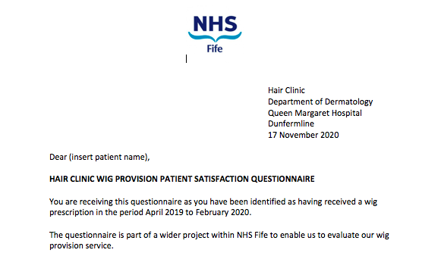
Wig provision in Fife; a patient satisfaction
questionnaire
R Jones¹, M Mowbray¹
¹Department of Dermatology, Victoria Hospital, Kirkcaldy, UK
Objective:
Patients with hair loss in NHS Fife can be referred to dermatology, where they will be assessed in a dedicated hair clinic. Clinical need for a wig may include physiological, psychological and lifestyle factors. The provision of a wig can dramatically improve the quality of life for an alopecia patient. NHS Fife spends approximately £120,000 per year on wig provision (includes other prescribers such as oncology). Given the cost of wig provision it is imperative that we provide a service that meets the needs of the patient and therefore is cost effective to NHS Fife. We wished to evaluate the process of wig provision and seek our patients views on the service along with any suggestions for improvement.
Results:
215 questionnaires were sent out and 132 responses were received. 92% of respondents stated they were provided enough information on obtaining a wig but only 77% of respondents felt they had been given enough information on wig providers. The main factors influencing choice of wig provider were location and word of mouth. 20.5% of respondents reported difficulties obtaining their wig; mostly due to time and expense associated with travelling to the wig provider. The median score with regards to wig fit was 9/10. 18% of respondents reported incurring additional costs when obtaining their wig; most commonly being charged for the wig to be cut and/ or styled.
Figure 2: 18% reported additional charges
YES- 18%
Method:
Patients who were provided with a wig in NHS Fife between 1 April 2019 and 31st March 2020 were sent a questionnaire relating to the wig provision process. A stamped addressed envelope was included for completed questionnaires to be returned to the dermatology department.
Conclusion:
We have altered our patient information leaflet to include pertinent information regarding suppliers and to affirm to patients that further costs with regard to their wig should not be necessary. We hope that in gaining a better understanding of the patient experience of wig provision we can guide patients more effectively through what is often an anxious time, and ensure they receive the most suitable product. This will ensure cost effectiveness to NHS Fife, while maintaining patient satisfaction.
Figure 1: Wig questionnaire letter

