Slide 1

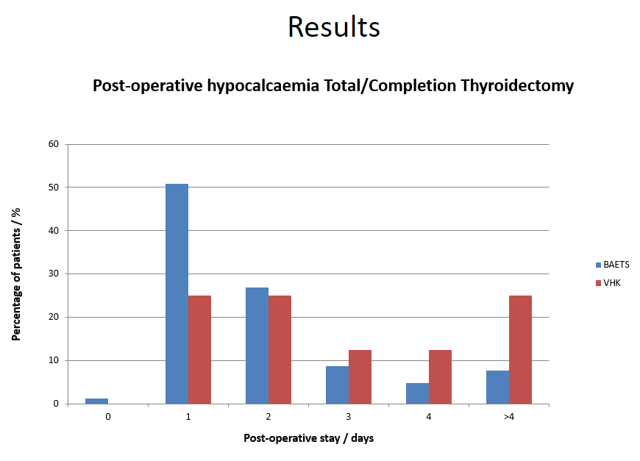
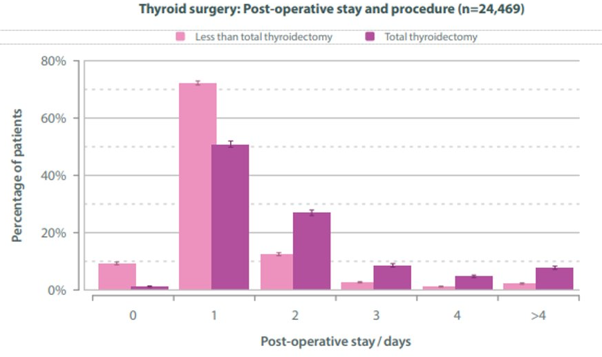
Post operative hypocalcaemia following Total & Completion Thyroidectomy
Authors: Dr Calum Fraser, Miss Valerie Kim, Mr David Walker
ENT Unit, Victoria Hospital Kirkcaldy
Introduction
Results
Hypocalcemia following total or completion thyroidectomy is a recognised complication. This occurs due to damage or removal of the parathyroid glands during surgery. The incidence in the UK is estimated to be approximately 23.5% of patients following this procedure. Almost 40% of post op patients receive calcium and/or vitamin D supplementation by the time of hospital discharge​ due to hypocalcaemia.
There are various options used by surgical teams pre-operatively to attempt to reduce the rates of post opertaive hypoclacaemia, however, there are no agreed regime or standardised national guidelines relating to this.​
Current trends show patients are having shorter length of hospital stay after thyroid surgery which has been ongoing since 2012​. It has been noted that on our own ENT ward in VHK there have been multiple prolonged stays due to hypocalcaemia following total or completion thyroidectomy. This was the trigger for this study.
A total number of eight patients were included in the audit. Six patients were found to have hypocalcaemia (<2.20mmol/l)​ following total or completion thyroidectomy.
​
Two patients required IV Calcium infusions due to Calcium levels of ​ (<1.80mmol/l).
​
Four patients were discharged on a variation of Calcium/Vitamin D supplements​.
​
One patient had stay of 16 days due to difficulties correcting hypocalcaemia. Endocrinology were involved to aid management.
Discussion
Hypocalcaemia following total/completion thyroidectomy is common. Hypocalcaemia rates in our centre are higher than the national average, with prolonged durations of admission. There are many possible causes for this and the current literature has been unable to determine how to prevent this in the pre-operative setting.
Given the proportion of patients discharged on calcium and vitamin D there may be a role for pre-operative supplementation to reduce the risk of post-operative hypocalcaemia. To assess this further we plan to measure Vitamin D levels at pre-operative assessment clinics for this group of patients. If the majority of patients are found to be Vitamin D deplete we will discuss the concept of starting Vitamin D supplements prior to surgery as standard practice.
The study sample size was samll and data was collected retrospectively. This study could be repeated and improved by using larger patient numbers and using prospective data.
Table 1. National data of patients requiring admission following thyroid surgery
Framework
Aims​
Determine if hypocalcaemia following total/completion thyroidectomy is an issue in the unit​
Implement change to address this issue ​
Objectives​
Quantify the incidene of hypocalcaemia in this patient group​
Quantify the length of hospital stay in this patient group​
Look at the management of hypocalcaemia in this patient group​
Standards​
Working to BAETS standards and guidance for around thyroidectomy.
Methods and Materials
Conclusions
Data was collected retrospectively assessing all patients having total or completion thyroidectomy in VHK over a 6 month period from November 2022 to April 2023. Patients were identified from elective theatre lists obtained from ENT secretaries.​
Data was collected from patient case​ notes and entered into database in anonymous format​.
​
Captured data included date of surgery, post operative calcium levels, length of stay and post operative management​.
Hypocalcaemia following total/completion thyroidectomy is common​
Discharged medications relating to hypocalcaemia is very variable​. Could a department standard be formulated?​
Pre-operative Calcium/Vitamin D levels are not routinely recorded at pre-op assessment​. Could this be a preventative measure?
Plan to re-audit measuring Vitamin D levels in pre-op assessment to measure incidence of low Vitamin D levels in this patient group
Contact
References
Calum Fraser
ENT Unit
Victoria Hospital, Kirkcaldy
Email: calum.fraser@nhs.scot
The British Association of Endocrine and Thyroid Surgeons. Fifth National Audit Report 2017 http://www.baets.org.uk/wp-content/uploads/BAETS-Audit-National-Report-2017.pdf. Accessed March 16, 2023 Google Scholar
McMurran, A., Blundell, R., & Kim, V. (2020). Predictors of post-thyroidectomy hypocalcaemia: A systematic and narrative review. The Journal of Laryngology & Otology, 134(6), 541-552. doi:10.1017/S0022215120001024

